Slide 1
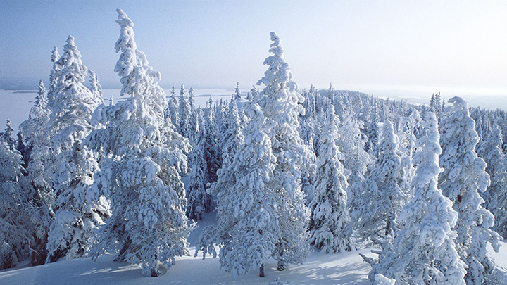
Refugees in Finland
GKPN
Lisbon, 10.3.2016
Mika Yrjölä

Slide 2
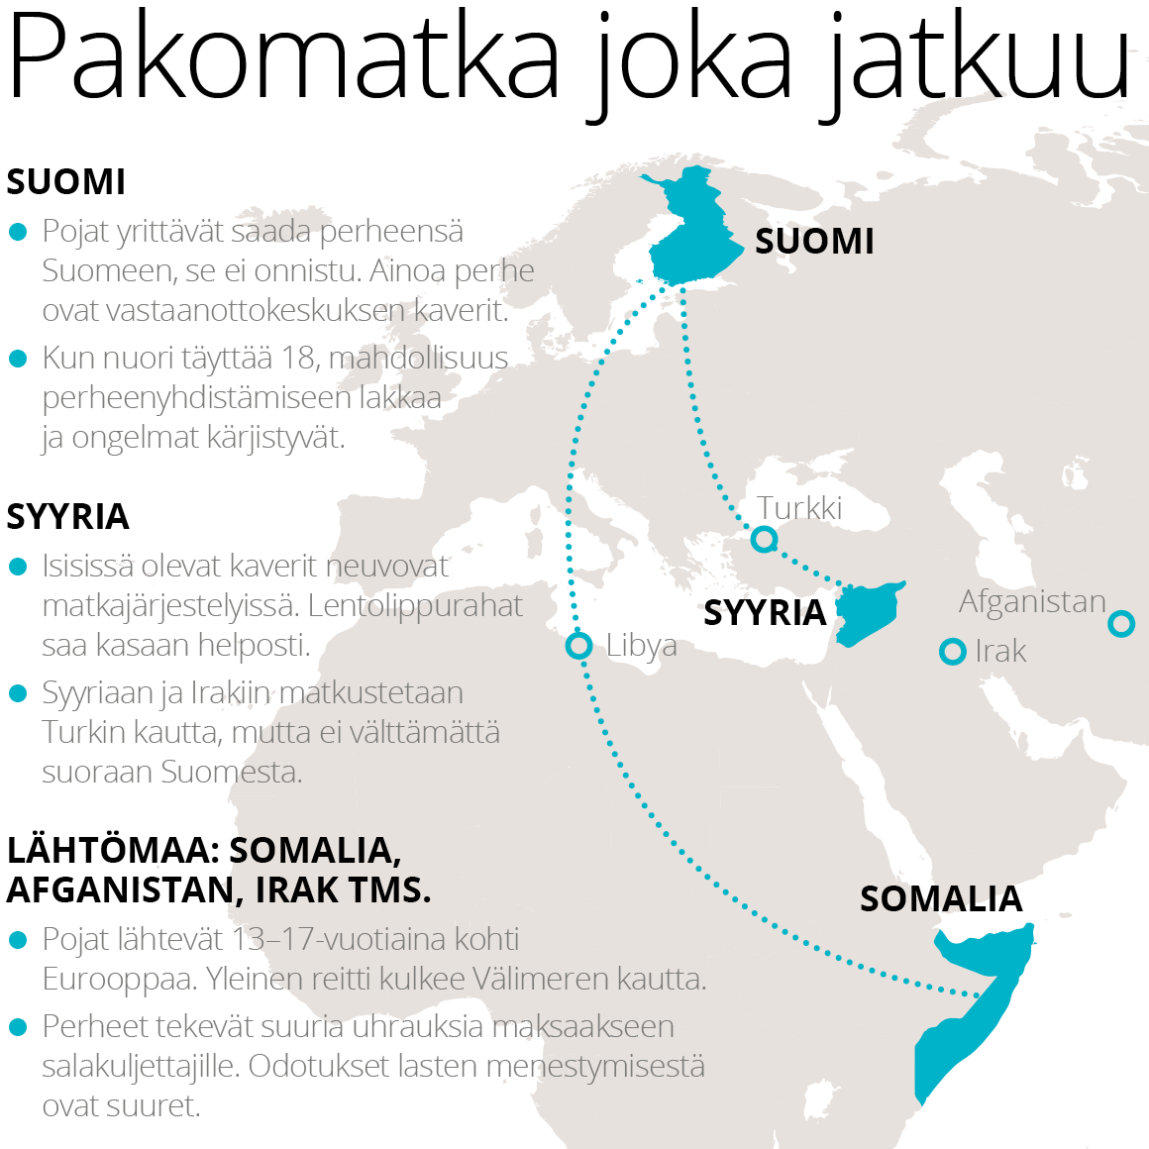
Summer/Fall 2015
32.500 Asylum seekers (2014: 3.500)
Iraq – 20.485
Afghanistan – 5.214
Somalia – 1.981
Syria – 877
142 Centers (2014: 18)
Estimated 10.000 will receive asylum
Summer 2016 & the Russian border is a question mark…

Slide 3
What is the response?
Nation divided / Churches open
A new momentum for missions in many churches
We sold what we could to get this ”priceless pearl”
Received clothing donations
Organized training for volunteers (200+ attending)
Weekly services/Bible studies in Farsi, Arabic, Dari (+4)

Slide 4
TV-programs
Total of 10 testimonies:
Kurdi
Farsi
Dari
Arabic
Somali
Russian
Lingala
French

Slide 5
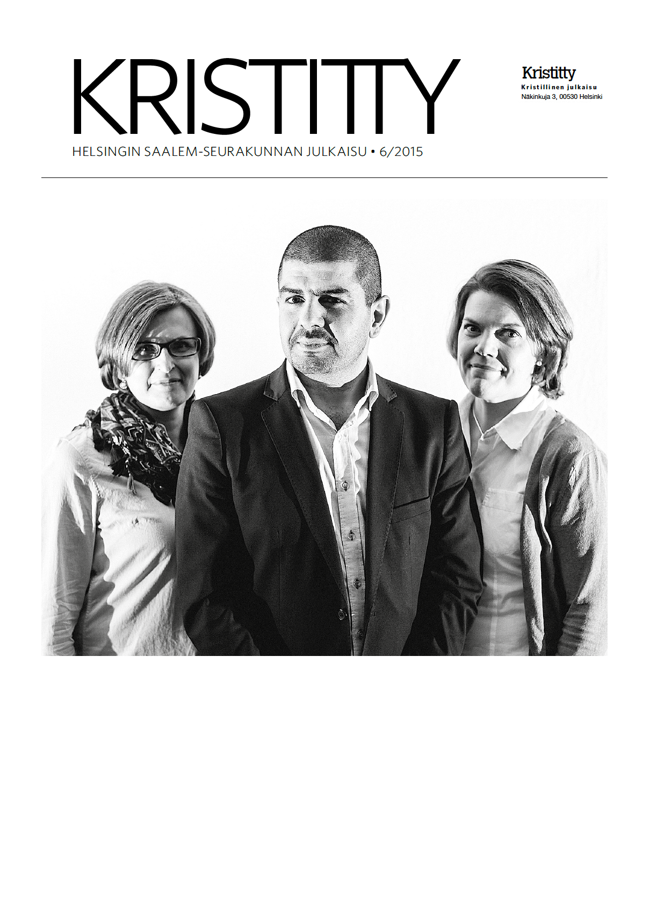
Response
Employed 3 people to work with refugees

Slide 6
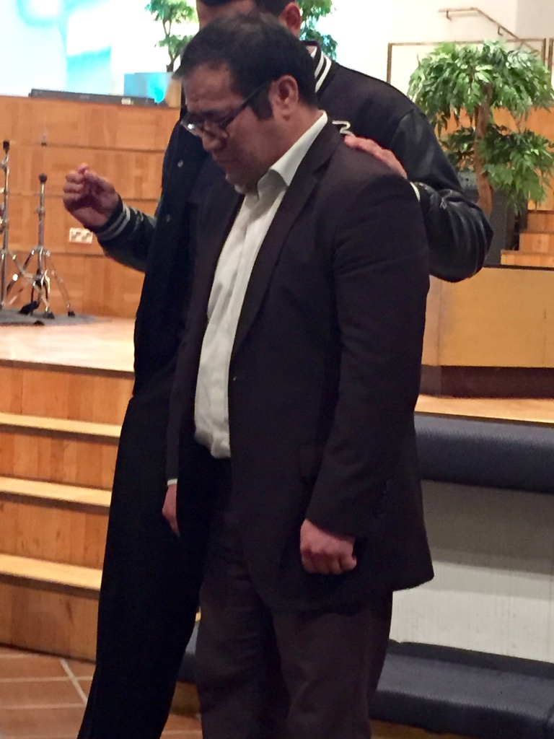
Response

Slide 7
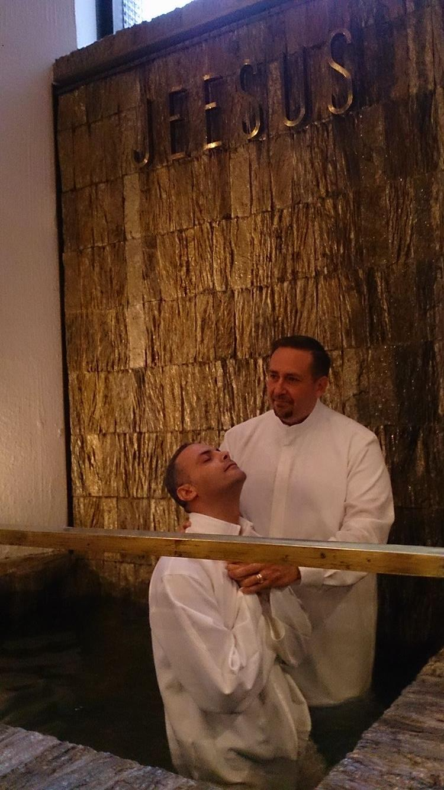
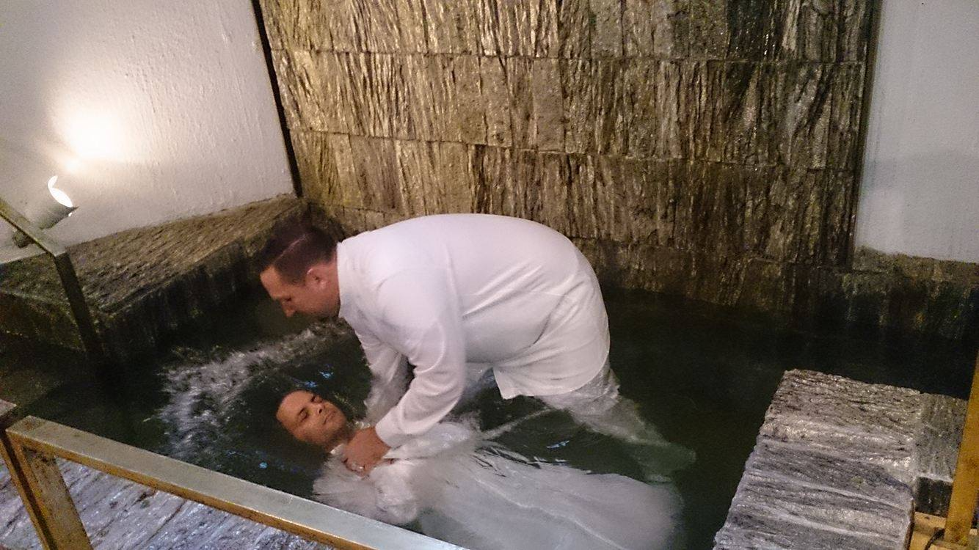
Response

Slide 8
Response

Slide 10
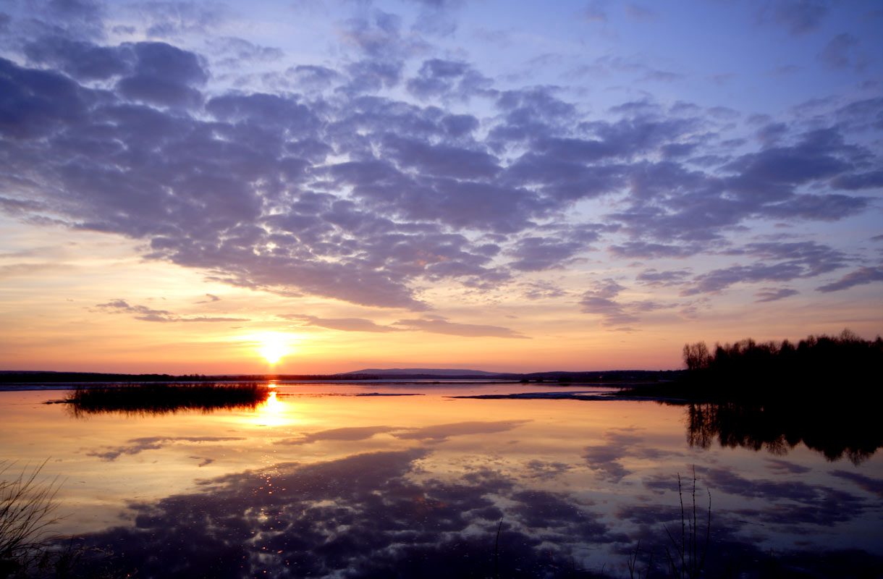
How can you help?
Pray: for laborers
Send: teams (Arabic, Dari, Somali, Farsi)

